Slide 1


Slide 2
DIRECTION SENSE

Slide 3


Concept
There are four main directions - East, West, North and South as shown below:
There are four cardinal directions - North-East (N-E), North-West (N-W), South-East (S-E), and
South-West (S-W) as shown below:

Slide 4
Concept
Four Important Points:
At the time of sunrise if a man stands facing the east, his shadow will be towards west.
At the time of sunset the shadow of an object is always in the east.
If a man stands facing the North, at the time of sunrise his shadow will be towards his left and at the time of sunset it will be towards his right.
At 12:00 noon, the rays of the sun are vertically downward hence there will be no shadow.

Slide 5
Concept
Main types of questions are given below:
Type 1:
Siva starting from his house, goes 5 km in the East, then he turns to his left and goes 4 km. Finally he turns to his left and goes 5 km. Now in what direction is he from his house?
Solution:
From the below diagram,
From third position it is clear he is in North direction.

Slide 6
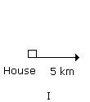
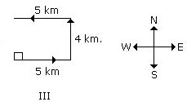
Concept
Type 2:
Suresh starting from his house, goes 4 km in the East, then he turns to his right and goes 3 km. What is the distance from the starting point?

Slide 7
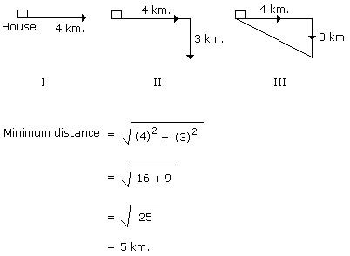
Concept
Solution:

Slide 8
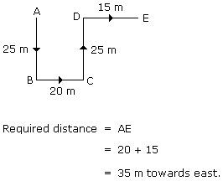
Concept
Type 3:
Rohit walked 25 m towards south. Then he turned to his left and walked 20 m. He then turned to his left and walked 25 m. He again turned to his right and walked 15 m. At what distance is he from the starting point and in which direction?
Solution:

Slide 9

Concept
Type 4:
One morning after sunrise Juhi while going to school met Lalli at Boring road crossing. Lalli's shadow was exactly to the right of Juhi. If they were face to face, which direction was Juhi facing?
Solution: In the morning sunrises in the east. So in morning the shadow falls towards the west.
Now Lalli's shadow falls to the right of the Juhi. Hence Juhi is facing South.

Slide 10
Question: 01
One morning after sunrise, Suresh was standing facing a pole. The shadow of the pole fell exactly to his right. To which direction was he facing?
A] North B] West C] South D] East

Slide 11
Explanation:
Sun rises in the east in the morning. Since the shadow of Suresh falls to his right. So he is facing South. So, option C is correct.

Slide 12
Question: 02
Reena walked from A to B in the East 10 feet. Then she turned to the right and walked 3 feet. Again she turned to the right and walked 14 feet. How far is she from A?
4 feet
5 feet
24 feet
27 feet

Slide 13
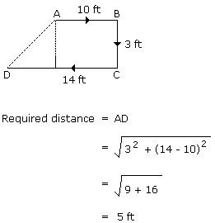
Explanation:

Slide 14
Question: 03
Four friends A, B, C and D live in a same locality. The house of B is in the east of A's house but in the north of C's house. The house of C is in the west of D's house. D's house is in which direction of A's house?
A] South-East B] North-West C] North-East D] East

Slide 15

Explanation:
Therefore, D's house is in the South-East direction of A.

Slide 16
Question: 04
Umesh directly went from P, to Q which is 9 feet distant. Then he turns to the right and walked 4 feet. After this he turned to the right and walked a distance which is equal from P to Q. Finally he turned to the right and walked 3 feet. How far is he now from P?
6 feet
5 feet
1 feet
0 feet

Slide 17
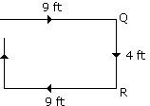

Explanation:
P
T
3 ft
S

Slide 18
Question: 05
Shyam walks 5 km towards East and then turns left and walks 6 km. Again he turns right and walks 9 km. Finally he turns to his right and walks 6 km. How far is he from the starting point?
26 km
21 km
14 km
9 km

Slide 19
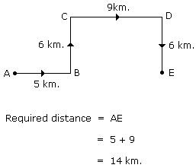
Explanation:

Slide 20
Question: 06
Amit started walking positioning his back towards the sun. After some time, he turned left, then turned right and towards the left again. In which direction is he going now?
A] North or South B] East or West C] North or West D] South or West

Slide 21
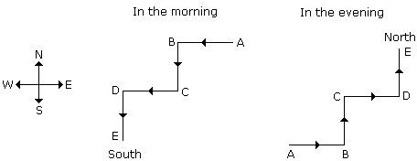
Explanation:
If he starts walking the morning then finally he will face towards South and if he starts in the evening then finally he will face towards North.

Slide 22
Question: 07
Mary is walking towards south-west for 15 miles, turns right and walks another 10 miles. She
then turns 90 degrees clockwise and walks 10 miles. Now, she again turns left and walks 30 miles. Which direction is she facing?
A] North-West B] South-East C] East
D] West

Slide 23
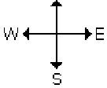


Explanation:
She is facing north west direction.

Slide 24
Question: 08
Village Q is to the North of the village P. The village R is in the East of Village Q. The village S is to the left of the village P. In which direction is the village S with respect to village R?
West
South-West C] South
D] North-West

Slide 25

Explanation:
S is to the South-West of R.

Slide 26
Question: 09
Radha moves towards South-East a distance of 7 km, then she moves towards West and travels a distance of 14 km. From here she moves towards North-West a distance of 7 km and finally she moves a distance of 4 km towards east. How far is she now from the starting point and in which direction?
A] 3 km- East B] 4 km- West C] 10 km- East D] 11 km- West

Slide 27
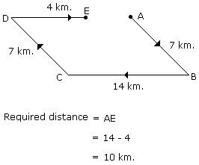
Explanation:

Slide 28
Question: 10
Sundar runs 20 m towards East and turns to right and runs 10 m. Then he turns to the right and runs 9 m. Again he turns to right and runs 5 m. After this he turns to left and runs 12 m and finally he turns to right and 6 m. Now to which direction is Sundar facing?
A] 1 m- East B] 1 m- West C] 1 m- North D] 1 m- South

Slide 29
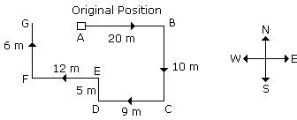
Explanation:
Therefore, it is clear that Sundar will face towards North.
Distance from starting point = (9+12) - 20
=21- 20 = 1 m

Slide 30
Question: 11
Sachin walks 20 km towards North. He turns 90 degree left and walks 40 km. He again turns 90 degree left and walks 20 km. Finally he moves 20 km after turning to the left. How far is he from his starting position?
20 km.
30 km.
50 km.
60 km.
Answer: A

Slide 31
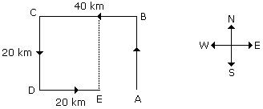
Explanation:
Required distance = 40 - 20 = 20 km.

Slide 32
Question: 12
Mira starts at point T, walks straight to point U which is 4 ft, away. She turns left, at 90 degree and walks to W which is 4 ft, away she turns 90 degree right and goes 3 ft, to P, turns 90 degree right and walks 1 ft, to Q, turns left at 90 degree and goes to V, which is 1 ft, away and once again turns 90 degree right and goes to R, 3 ft, away. What is the distance between T and R?
4 ft.
5 ft
7 ft.
8 ft.
Answer: D

Slide 33
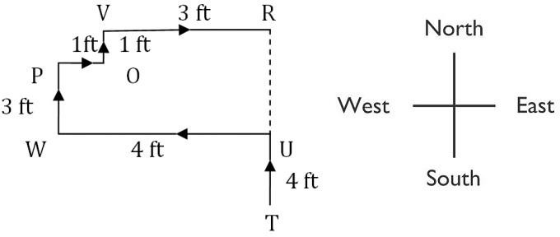
Explanation:
Q
Distance between T and R = TR = TU + UR = TU + PW + QV = ( 4 + 3 + 1) ft = 8 ft.

Slide 34
Question: 13
From his house, Lokesh went 15 km to the North. Then he turned west and covered 10 km. Then he turned south and covered 5 km. Finally turning to the east, he covered 10 km. In which direction is he from his house?
A] East B] West C] North D] South
Answer: C

Slide 35
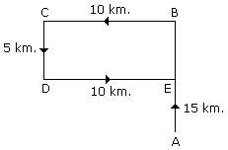
Explanation:
Therefore, it is clear that he is in the North from his house.

Slide 36
Question: 14
After walking 6 km, I turned 90 degree to the right and then walked 2 km. After then I turned 90 degree to the left and walked 10 km. In the end, I was moving towards the North. From which direction did I start my journey?
A] North B] South C] East D] West
Answer: B

Slide 37

Explanation:
The journey was started from the South.

Slide 38
Question: 15
Ravi left home and cycled 10 km towards South, then turned right and cycled 5 km and then again turned right and cycled 10 km. After this he turned left and cycled 10 km. How many kilometers will he have to cycle to reach his home straight?
10 km
15 km
20 km
25 km
Answer: B

Slide 39
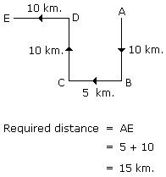
Explanation:

Slide 40
THANK YOU

